Slide 1
WISE BUYERS VERSUS CONSPICUOUS CONSUMER
MELAK ALRADHI

Slide 2
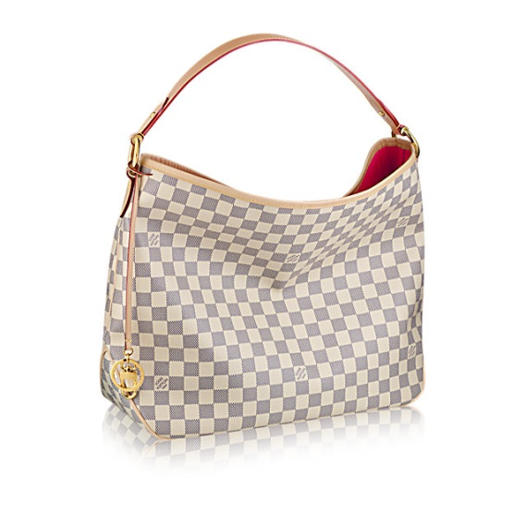
Conspicuous Buy: Louis Vuitton
Louis Vuitton handbag Delightful MM
Price: $1,390.00
Why is it conspicuous?
It’s so popular
Why is it expensive?
luxuriously soft embossed handle make it chic yet practical.

Slide 3
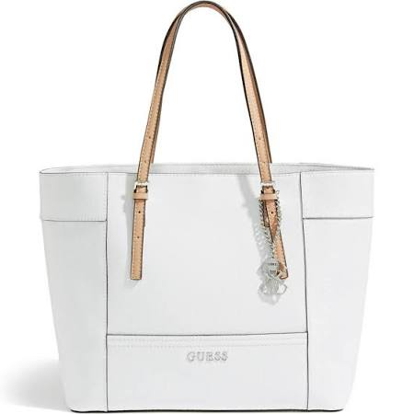
Wise Buy: Guess handbag
GUESS Women's Delaney Textured Logo Medium Classic Tote
Price: $108.00
Why is it wise?
This handbag is cheaper and it still nice

Slide 4
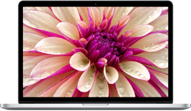
Conspicuous Buy: MacBook Pro
13-inch MacBook Pro with Retina display
Price: $1,499.00
Why is it conspicuous?
The laptop is the most wanted laptop in the market
Why is it expensive?
2.7GHz Processor
256 GB Storage

Slide 5
Wise Buy: hp- laptop
HP - Pavilion X360 2-in-1 13.3" Touch-screen Laptop
Price: $499.99
Why is it wise?
This laptop is cheaper
4 GB memory-500 GB hard drive

Slide 6
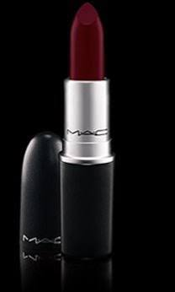
Conspicuous Buy: mac lipstick
Mac Absolute Power Matte Lipstick
Price: $29.95
Why is it conspicuous?
Everyone likes it
Why is it expensive?
High quality

Slide 7
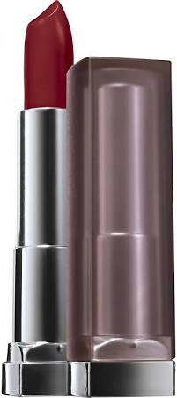
Wise Buy: Maybelline lipstick
Maybelline Color Sensational Creamy Matte Lip Color
Price: $4.99
Why is it wise?
This lipstick is cheaper but it is high quality.

Slide 8
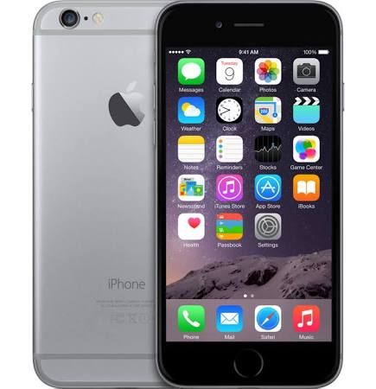
Conspicuous Buy: iPhone 6
Apple iPhone 6 Smartphone 64 GB
Price: $749.97
Why is it conspicuous?
This phone is the most wanted phone in the market
Why is it expensive?
This iPhone has 64gb and is the newest model

Slide 9
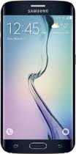
Wise Buy: Samsung - Galaxy S6
Samsung - Galaxy S6 Edge With 64gb Memory Cell Phone
Price: $399.99
Why is it WISE?
This phone is cheaper but has similar functions

Slide 10
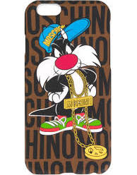
Conspicuous Buy: MOSCHINO COVER
Moschino Sylvester iPhone 6 cover
Price: $70.00
Why is it conspicuous?
Everyone wants it
Why is expensive?
It is a high quality and it is popular

Slide 11
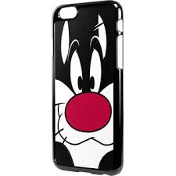
Wise Buy: iPhone 6 cover
Sylvester - iPhone 6 Black LeNu Case
Price: $14.99
Why is it wise?
This iPhone cover is cheaper but it is similar to the other one

Slide 12
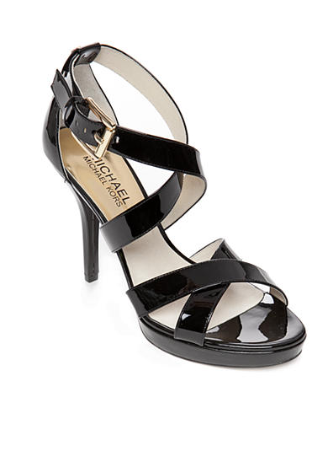
Conspicuous Buy: michael kors heels
MICHAEL Michael Kors Eve Platform.
Price: $135
Why is it conspicuous?
It is so popular
Why is expensive?
Rubber sole
Lightly padded leather insole

Slide 13
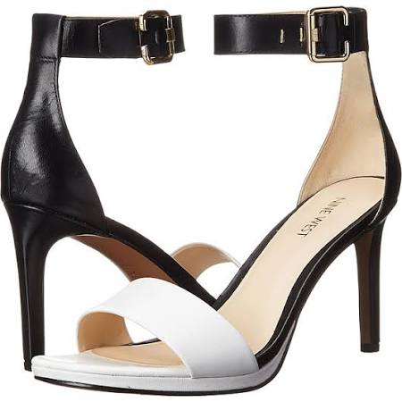
Wise buy: nine west heels
Nine West Meantobe Two-Piece Ankle Strap Sandals
Price: $59.99
Why is it wise?
This shoes is cheaper
Polished leather upper

Slide 14
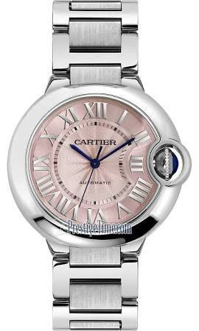
Conspicuous Buy: Cartier Watch
Cartier Ballon Bleu 36mm w6920041
Price: $4,650
Why is it conspicuous?
Everyone wants it and it is popluar
Why is it expensive?
Brushed & polished Stainless Steel Case
Bracelet Pink textured dial Roman numeral

Slide 15
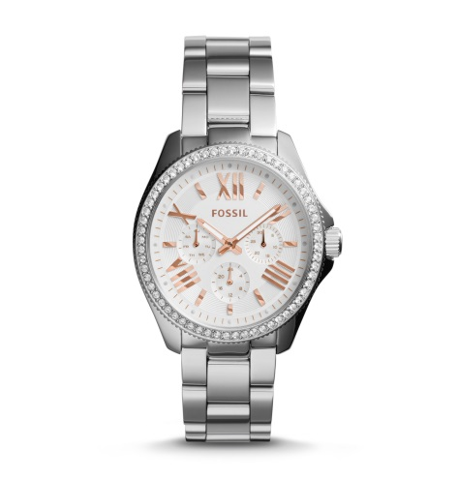
Wise buy: fossil watch
Cecile Multifunction Stainless Steel Watch New
Price: $145
Why is it wise?
This hand watch is cheaper but it has similar functions

Slide 16
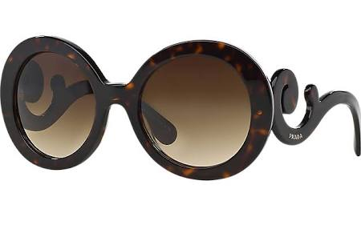
Conspicuous Buy: Prada sunglasses
Prada Pr27ns Brown Round Sunglasses
Price: $300.00
Why is conspicuous?
Every one wants is
Why is it expensive?
High quality materials
It has Prada’s signature on it

Slide 17
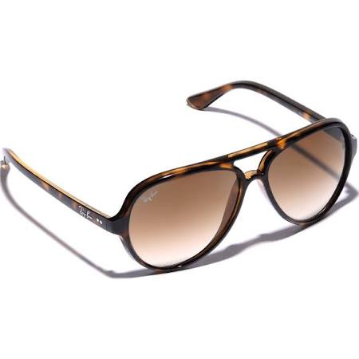
Wise buy: ray ban sunglasses
Ray-Ban Plastic Aviator Sunglasses Tortoise
Price: $105
Why is wise?
This sunglasses is cheaper but it still popular
High quality materials

Slide 18
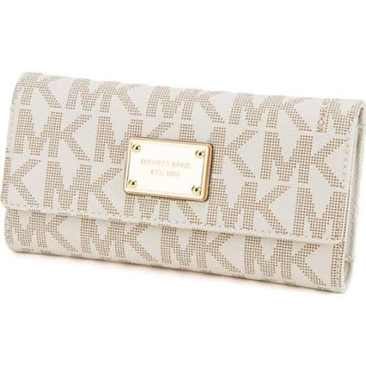
Conspicuous Buy: michael kors wallet
Michael Kors Women's Jet Set Checkbook Wallet
Price: $145.99
Why is conspicuous?
The brand is the most wanted brand in the market
Why is it expensive?
scratch-resistant Saffiano leather with signature detailing

Slide 19
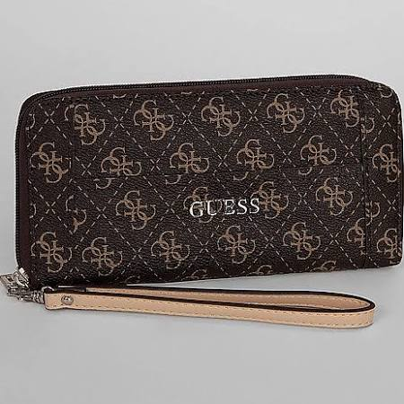
Wise buy: guess wallet
Guess Delaney Wallet
Price: $45.00
Why is wise?
This wallet is cheaper but it is faux leather wallet
It is the same size as the other wallet

Slide 20
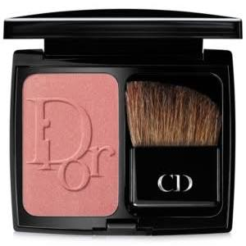
Conspicuous Buy: Dior blush
Dior Vibrant Color Powder Blush
Price: $43.00
Why is it conspicuous?
It is wanted by everyone because of its high quality
Why is expensive?
Its formula provides a pop of lasting color
It comes with an angled blush brush that provides flawless and precise application

Slide 21
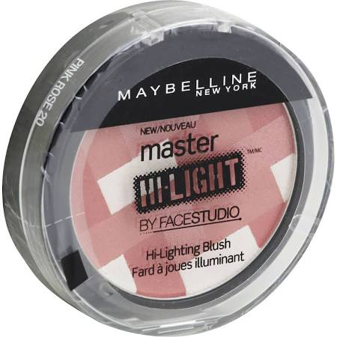
Wise buy: Maybelline blush
Maybelline Face Studio Master Hi-Light Blush
Price: $7.99
Why is it wise?
This blush is cheaper but it is still popular and has good quality

