Slide 1
product research
BY: MELAK AL RADHI

Slide 2
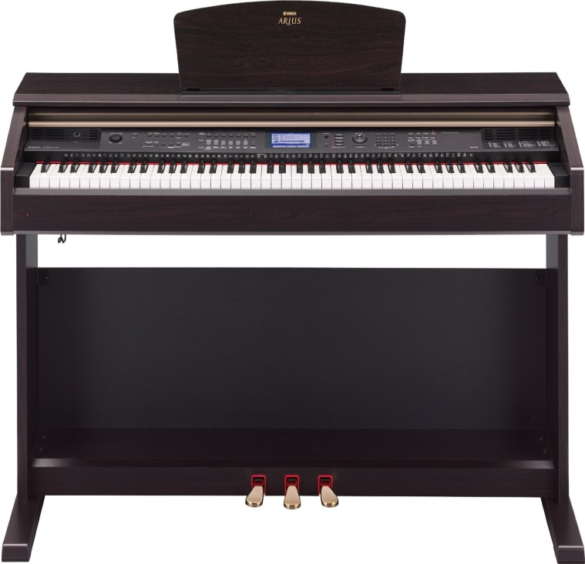
Yamaha ARIUS YDP-V240 Digital Piano
Price Range: $1,999.99
Demand factors:
Musicians want it
People like to listen to it
Supply factors:
It is manufactured
Not handmade
Elasticity:
This is an elastic product, if the price increases people will buy other brands.

Slide 3
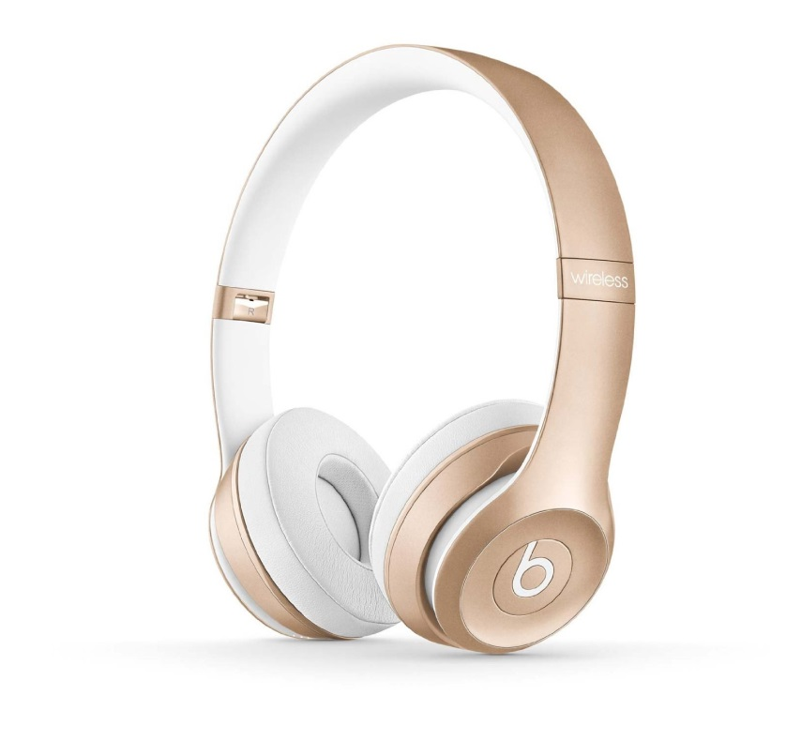
Beats Solo 2 Wireless On-ear Headphones
Price Range: $269.65
Demand factors:
Very popular
Has a high quality
Supply factors:
High quality materials
Last for long
Elasticity:
This is an elastic product. If the price increases, people will buy other brands.

Slide 4
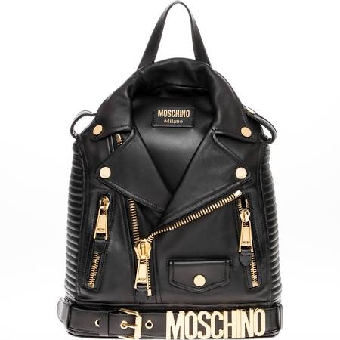
Fashion Moschino Motorcycle Jacket Backpack Handbag
Price Range: $1,799.99
Demand factors:
It is attractive
It is a famous brand
Supply factors:
High quality leather
Last for longer time
Elasticity:
This is an elastic product. If the price increases, people will buy other brands.

Slide 5
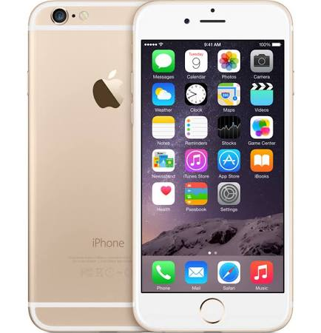
iPhone 6 - 64GB - Unlocked & SIM-Free - Gold/White - Apple
Price Range: $749.00
Demand factors:
People need its services
Very popular now
Supply factors:
High quality materials
Smooth metal service
Elasticity:
This is an elastic product. If the price increases, people will buy something else.

Slide 6
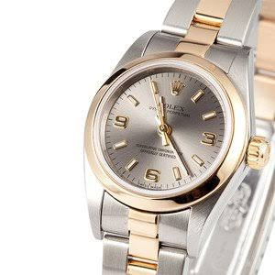
Ladies Rolex Oyster Perpetual Two Toned 76183
Price Range:$4,100.00
Demand factors:
It is attractive
High quality brand
Supply factors:
Stainless steel case with 18k yellow gold smooth bezel
Silver dial with baton markers and Arabic numerals
Elasticity:
This is an elastic product. If its price increases, people will buy other bransd.

Slide 7
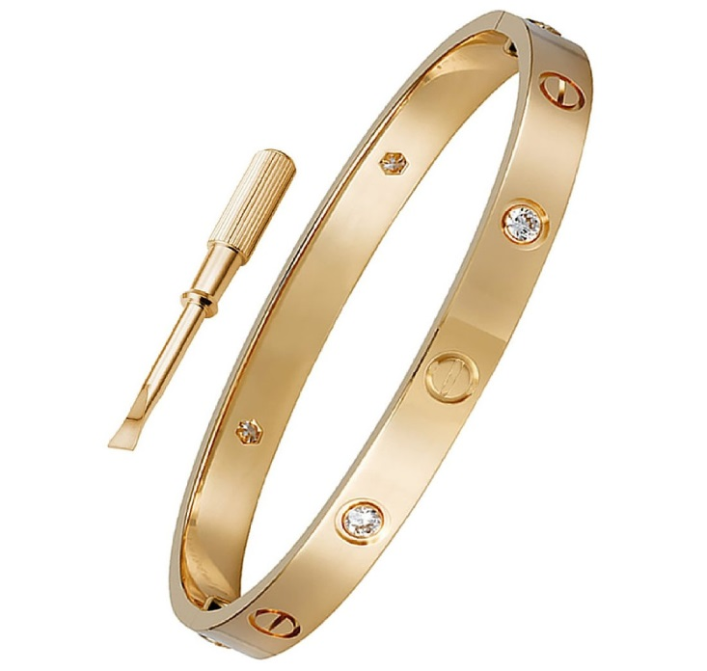
OMFEE Stainless Steel Inspired Crystal Screw Head Driver Oval Love Bangle Bracelet
Price Range: $32.99
Demand factors:
It is attractive
It is popular
Supply factors:
It is manufactured
Not handmade
Elasticity:
This is an elastic product. If the price increases, people will buy other brands.

Slide 8
Moschino Raised Logo Letters iPhone
Price Range: $25.99
Demand factors:
It is attractive
It is popular
Supply factors:
High quality
Manufactured product
Elasticity:
This is an elastic product. If the price increases, people will buy other stuff.

Slide 9
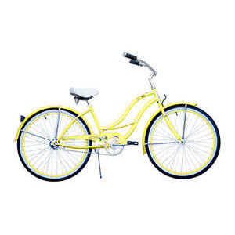
Micargi Bicycles Women's Tahiti 26“
Price Range: $199
Demand factors:
People want them
Bicycles are popular
Supply factors:
Cheap materials
Manufactured materials
Elasticity:
This is an elastic product, if its price increases, people will buy other brands.

Slide 10
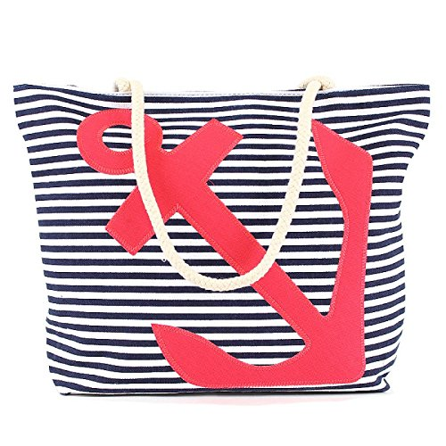
Anchor - Stitched Stripe Canvas Beach Bag
Price Range: $29.99
Demand factors:
It fit a lot of stuff
It is attractive
Supply factors:
Cheap materials
It’s manufactured
Elasticity:
This is an elastic product. If the price increases, people will buy other brands.

Slide 11
Adeco Decorative Black Wood "Family" Wall Hanging Collage Picture
Price Range: $35.01
Demand factors:
It is attractive
It is good for the design
Supply factors:
Easy to hang; saw tooth hook on back
Cheap materials
Elasticity:
This is an elastic product. If the price increases, people will buy other products.

