Slide 1
BANK COMPARISON
MELAK AL RADHI

Slide 2
My savings direct
Where is it?
It’s a traditional savings bank, Emigrant Bank,
APY 1.25%
Minimum Balance to Open= no minimum balance required
Fees= no fees
Transaction Limit= N/A
Why is it good? your account is FDIC insured up to the legal limit and always secure

Slide 3
Sfgi direct
Where is it?
SFGI Direct is an online division of Summit Community Bank
APY 1.06%
Minimum balance to open= $500 deposit minimum is required
Fees= no fees
Transaction limit= There is no maximum dollar limit of any single External Transfer to or from any SFGI Direct Savings account
Why is it good? . Each depositor is insured up to the maximum amount allowed by the FDIC Deposit Insurance Coverage Limit in affect

Slide 4
Saleem Five Direct
Where is it?
It is from traditional bank and has online access
APY 0.25%
Minimum Balance to Open=$100
Fees= no fees for ATM transactions conducted at non-Salem Five ATMs, for other banks charge up to $15 per statement cycle
Transaction Limit: ATM and PIN based transactions do not qualify.
Why is it good? provides customers of Salem Five with full deposit insurance on all of your deposit accounts

Slide 5
Discover
Where is it?
It is from a traditional bank
APY 0.95%
Minimum Balance to Open = $500
Fees= free
Transaction Limit: N/A
Why is it good? Annual Interest Earned on $5,000 Balance Info

Slide 6
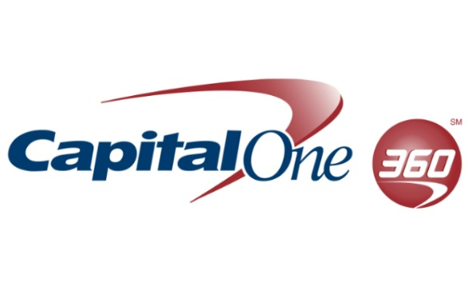
Capital one 360
Where is it?
It is from a traditional bank with online access
APY 0.75%
Minimum Balance to Open = Deposit $5,000 or more from an external account within the first 10 days of opening and maintain that balance daily for 90 days to qualify for a $50 bonus.
Fees= no fees
Transactions Limit: N/A
Why is it good? a better everyday savings interest rate, better access to your money and no fees

Slide 7
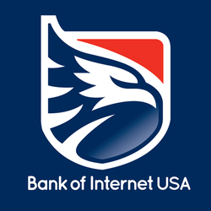
Bank of internet usa
Where is it?
It is from a traditional bank with online access
APY 0.20%
Minimum Balance to Open= $100
Fees= no monthly maintenance fee
Transactions limit: N/A
Why is it good? Competitive tiered variable rate account. Account balances greater than $24,999.99 will earn the variable ongoing APY for our highest tier on the full account balance1

